Slide 1
Data Management Patterns
Microservice Ch4 introduction

Slide 2
Data Management Patterns
The pattern to communicate between services
Make the whole system scalable
CQRS
Event sourcing
Saga pattern

Slide 3
CQRS
Command Query Responsibility Segregation
Split system to command part and query part
Query data and send command to update data

Slide 4
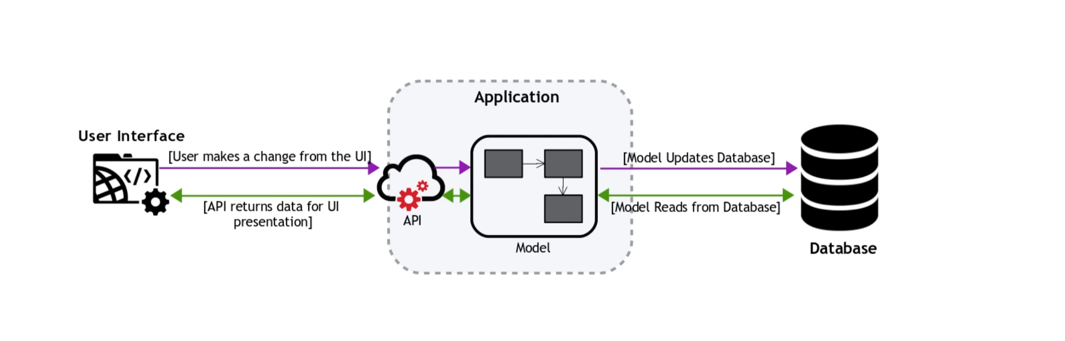
Traditional modeling
One DB and one model
A model can have both read and write actions
When you do read most of the time, you might need only parts of the model.

Slide 5
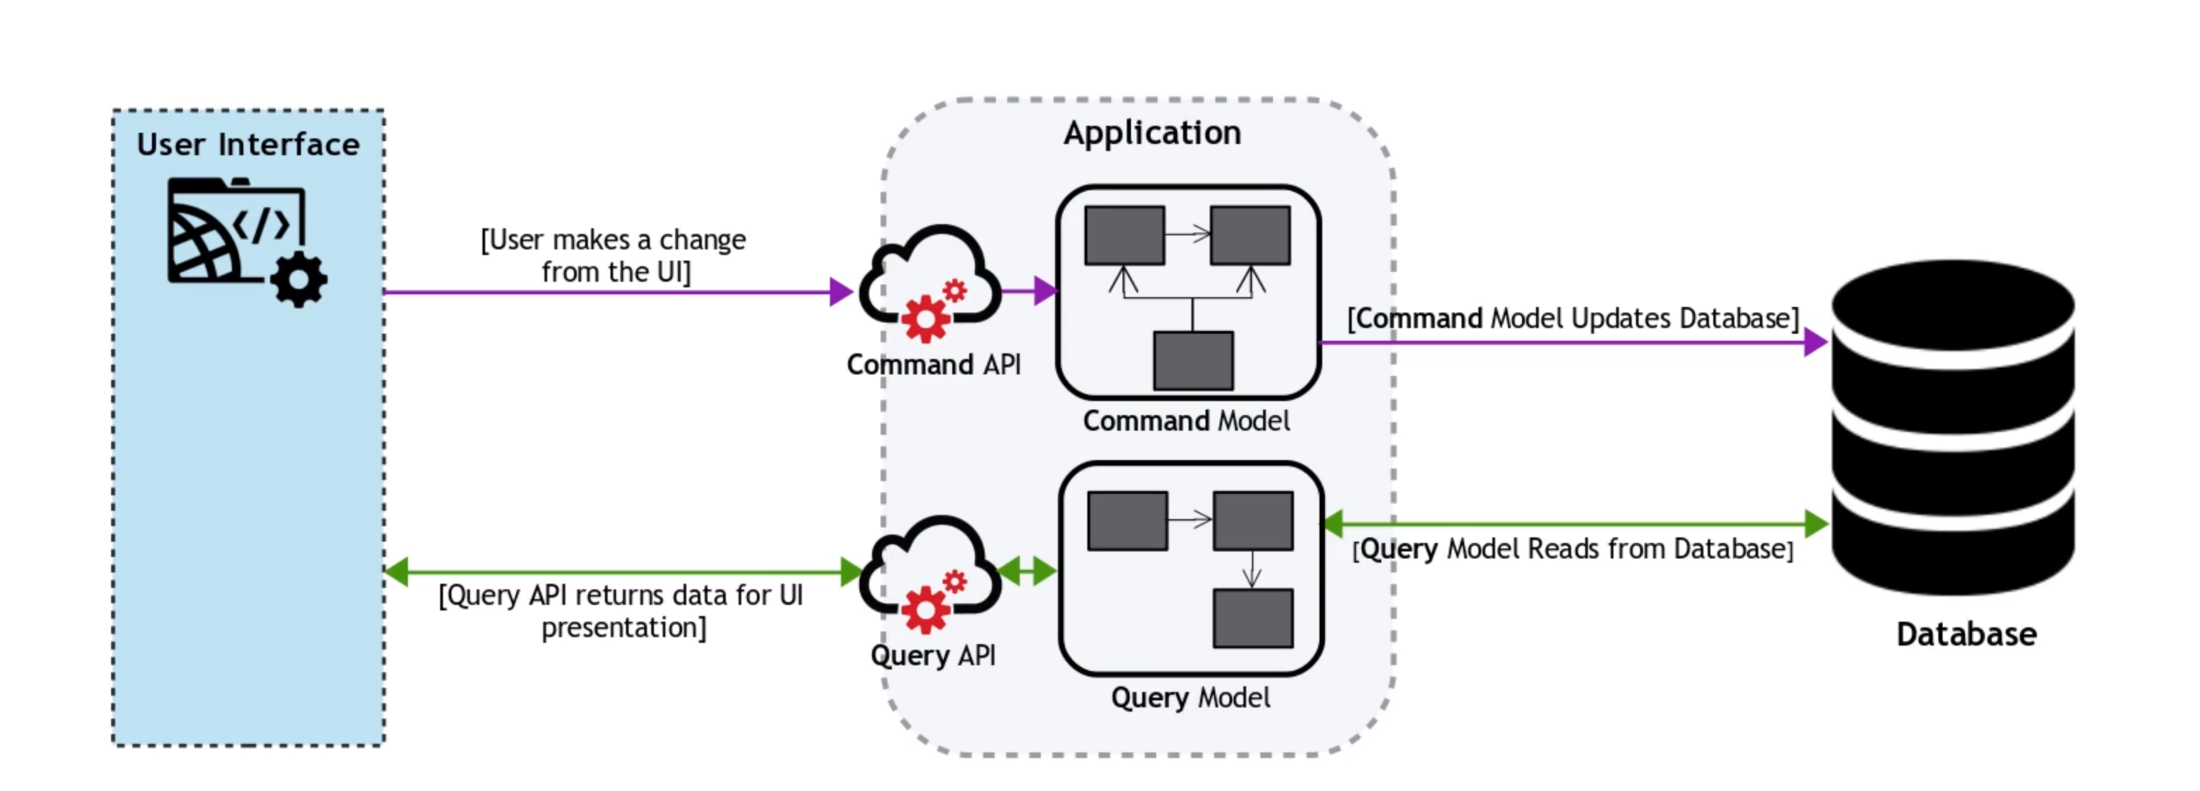
How does CQRS do
Now command and query are separated
You can scale one part up without affecting the other one
Usually reading requests are more than updating.
Benefits
Scale up one part
Fine tune indexes
Better modeling
Permission control
Notes:
Indexes
Read needs indexes
Write doesn't

Slide 6
Event sourcing
It defines an approach where all changes that are made to an entity, are stored as a sequence of immutable events to an event store.
Whenever the state of entiy is changed, a new event is created and appened to the event list.
"Event" is the fact that represent the fact happens to the system.

Slide 7
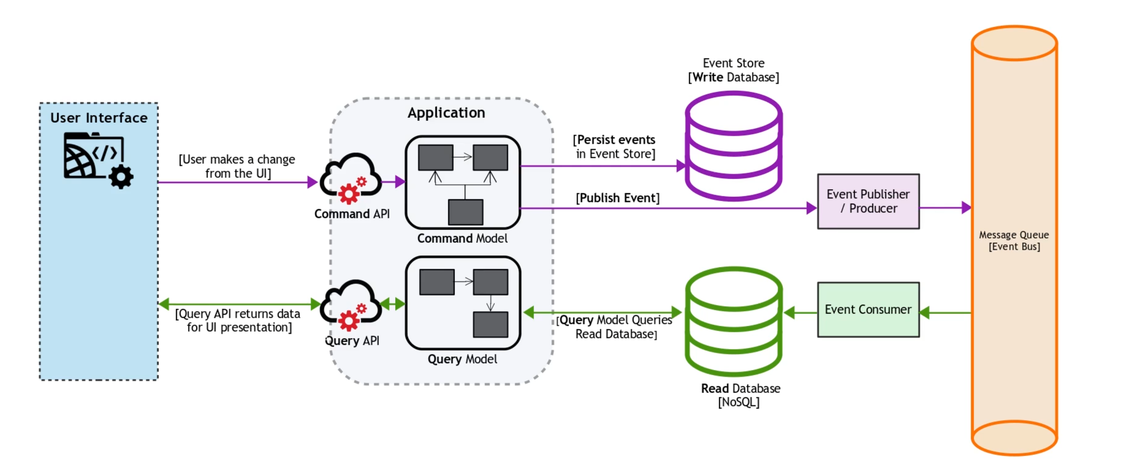
Event sourcing

Slide 8
Event sourcing
You can think event as a git commit
Log every single step
It can be used in multiple read database
It can revert or reproduce data to certain state easily

Slide 9
Saga pattern
What if a request refer data from mulitple micro services/DBs?
Distributed transaction
Like single DB transcation, distributed transaction still complies ACID
A saga pattern can be defined as a sequence of local transcations(Events). Where each microservices execute one or more transactions locally, and then publish an event to trigger the next transcation(s) at the next service.
What if it failed? Do compensation transcations to revert everything

Slide 10
Two ways
Choreography saga pattern
Like Ad-hoc
Orchestration Saga Pattern
A centralized controller that publish and subscribe response
Pass event through event bus(message queue)
So here is where the event sourcing is applied.

Slide 11
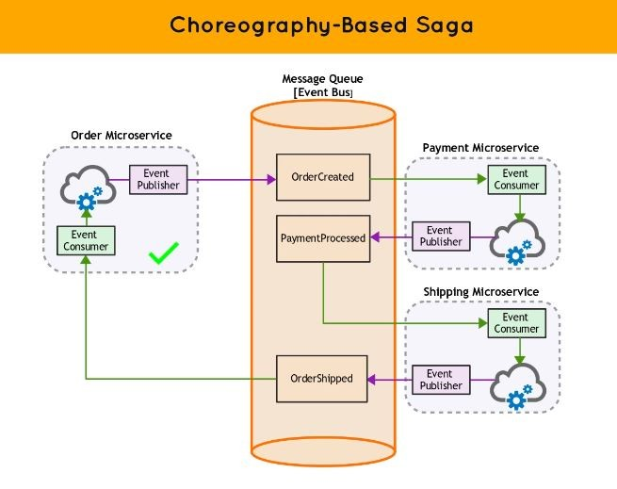
Choreography saga pattern
按一下以新增文字
Notes:
REF: https://www.linkedin.com/pulse/saga-pattern-classification-saral-saxena/

Slide 12
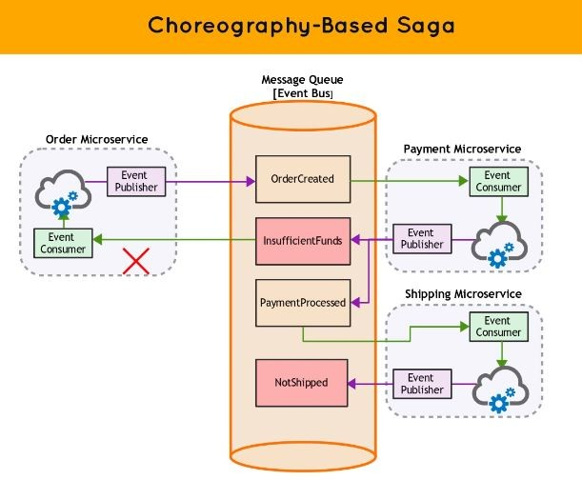
Choreography saga pattern

Slide 13
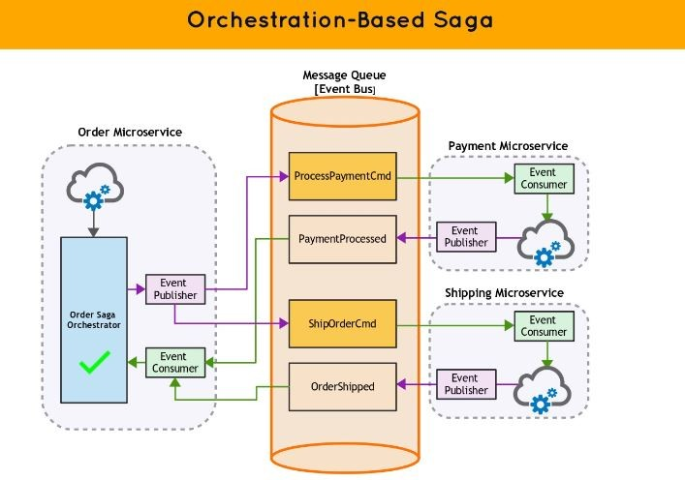
Orchestration Saga Pattern

Slide 14
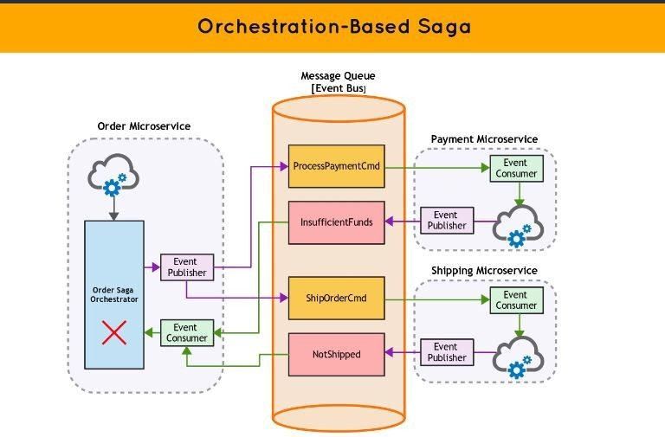
Orchestration Saga Pattern

Slide 15
Q&A

